Slide 1
Icinga2 installation Using Hiera

Slide 2


Agenda
Hiera 1: Overview
The hiera.yaml Config File
Creating Hierarchies
Lookup Types
Writing Data Sources

Slide 3
Hiera 1: Overview
Hiera is a key/value lookup tool for configuration data, built to make Puppet better and let you set node-specific data without repeating yourself.
Hiera makes Puppet better by keeping site-specific data out of your manifests. Puppet classes can request whatever data they need, and your Hiera data will act like a site-wide config file.
This makes it:
Easier to configure your own nodes: default data with multiple levels of overrides is finally easy.
Easier to re-use public Puppet modules: don’t edit the code, just put the necessary data in Hiera.

Slide 4
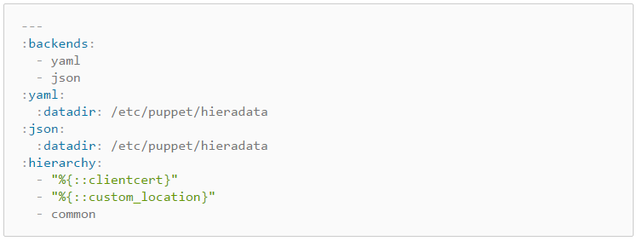
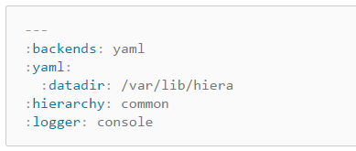
The hiera.yaml Config File
Default Hiera.yaml

Slide 5
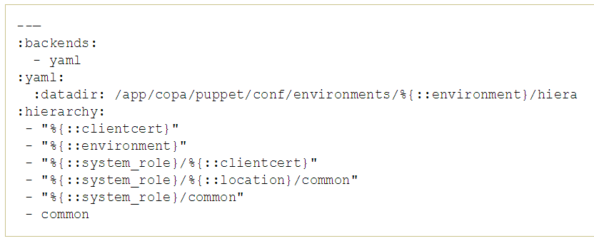
Comcast magnato puppet hiera.yaml

Slide 6
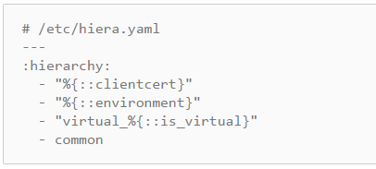
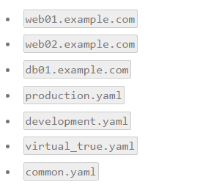
Creating Hierarchies

Slide 7
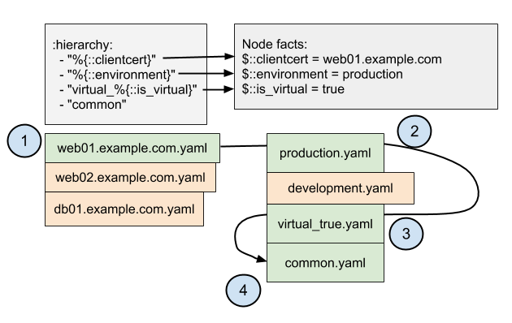

Slide 8
Lookup Types
Priority (default) (Hiera)
Array Merge (Hiera_array)
Hash Merge (Hiera_hash)
hiera icinga2::icinga_installation::feature fqdn=restool-cmcd-04c.sys.comcast.net
{"a"=>{"feature"=>"api"}, "b"=>{"feature"=>"command"}, "c"=>{"feature"=>"ido-mysql"}, "d"=>{"feature"=>"notification"}}
restool-cmcd-04c.sys.comcast.net.yaml
hiera -h icinga2::icinga_installation::service_restart
{"a"=>{"service"=>"ido2db"}, "b"=>{"service"=>"icinga2"}}
restool-cmcd-04c.sys.comcast.net.yaml
Common.yaml

Slide 9
hiera -a classes fqdn=restool-cmcd-04c.sys.comcast.net
["a", "b", "c", "d"]
restool-cmcd-04c.sys.comcast.net.yaml
Common.yaml

Slide 10
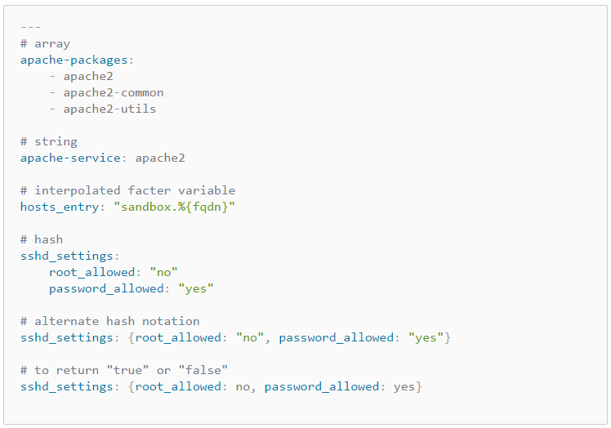
Writing Data Sources
JSON
YAML

Slide 11
cat icinga_installation.pp
class icinga2::icinga_installation {
$rpm_hiera = hiera('icinga2::icinga_installation::rpm_pre')
$tag_rpm = { tag => 'rpm‘ }
create_resources(icinga2::icinga_installation::packages,$rpm_hiera,$tag_rpm)
define icinga2::icinga_installation::packages ($rpm){
package { $rpm:
ensure => latest,
}
}
cat common.yaml
icinga2::icinga_installation::rpm_pre:
a:
rpm: gcc
b:
rpm: glibc
c:
rpm: glibc-common

